Slide 1
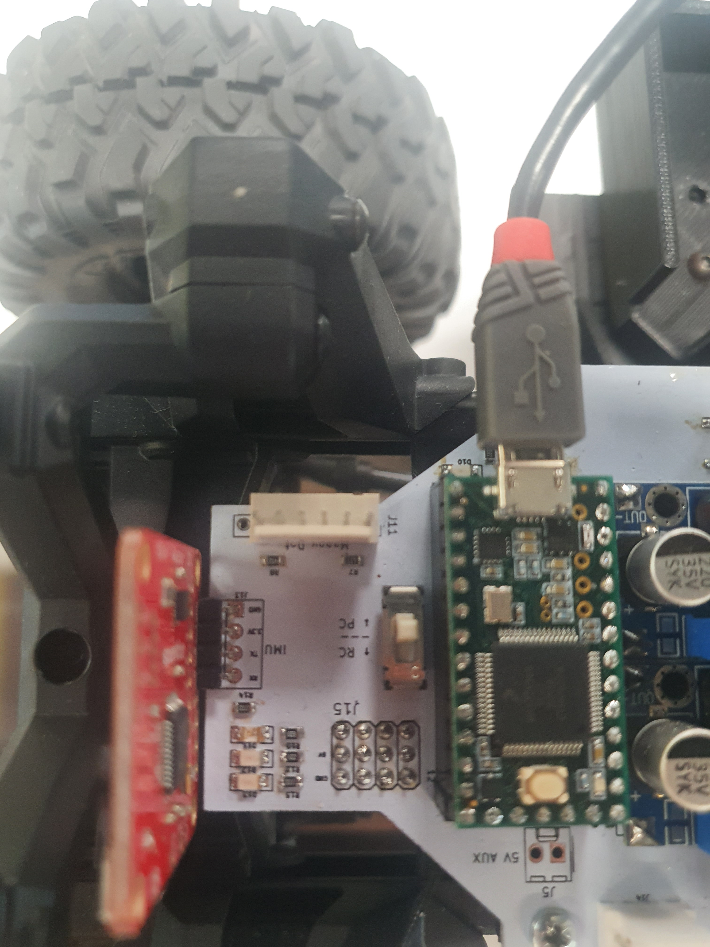
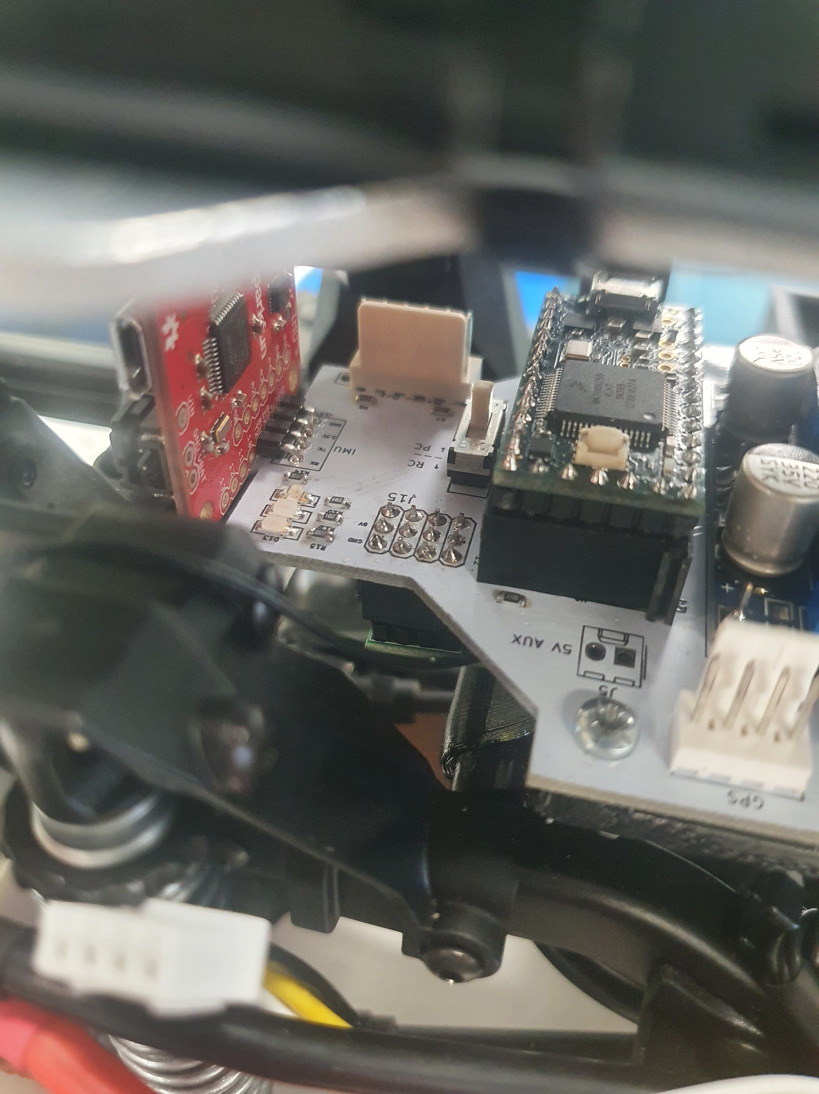
PC/RC Mode Switch

Slide 2
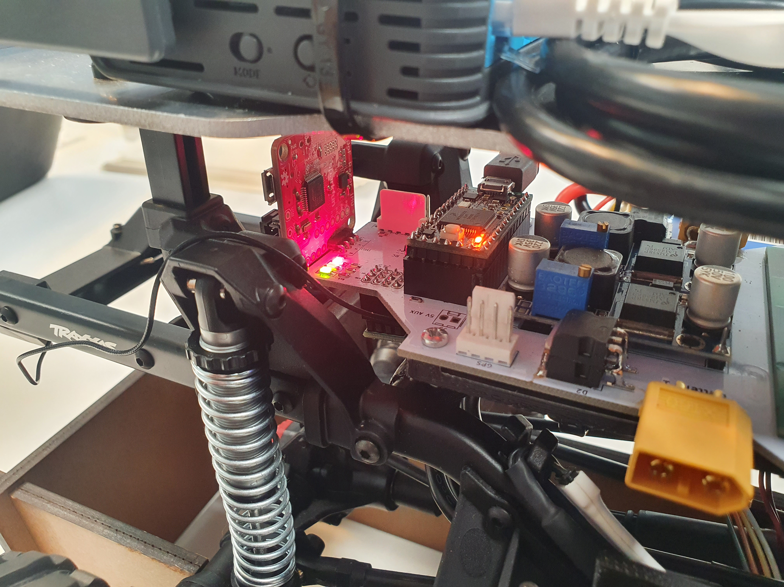
Movement Disabled
Comms Failure
Heart Beat

Slide 3
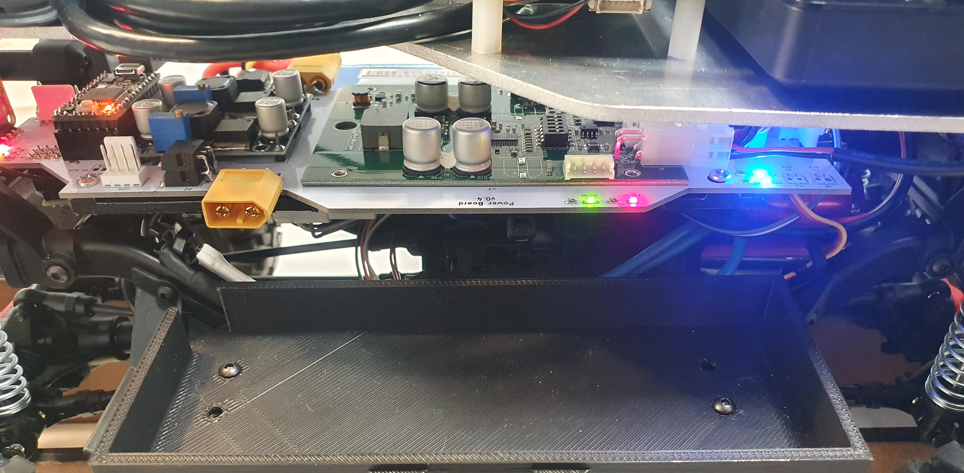
6V Aux Power
5V Aux Power

Slide 4
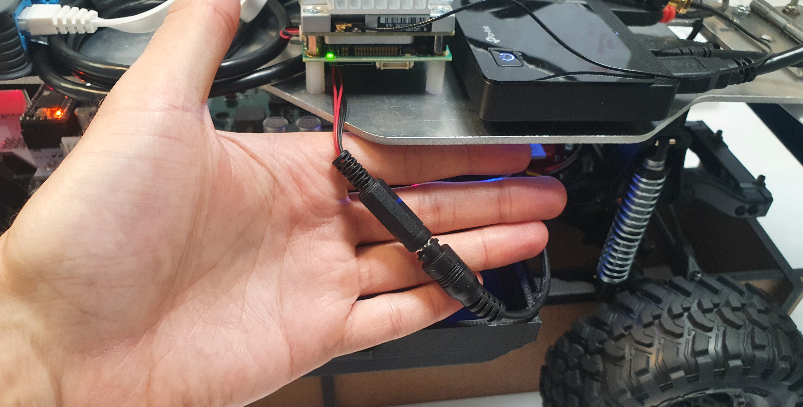
12V Aux Power Create Intermediate Cable

Slide 5
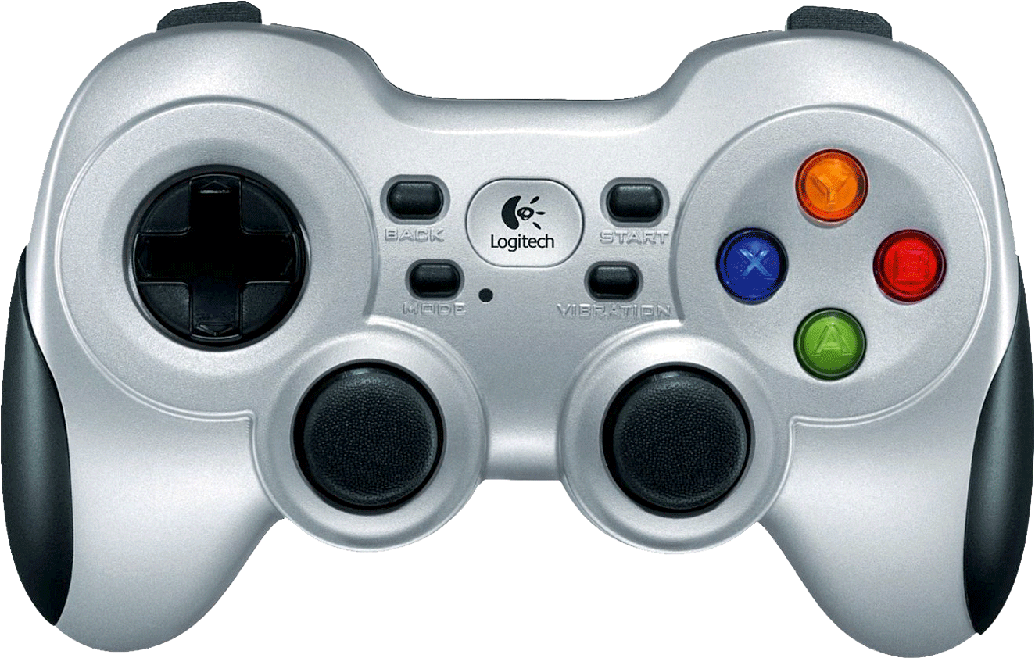
LB Hold for Autonomous Deadman Switch
RB Hold for Teleop Deadman Switch
Left Joystick Teleop Velocity
Right Joystick Teleop Steering

